Slide 1


Department of Computer Science and Engineering
A Machine Learning Framework for Early Stage Detection of Autism Spectrum Disorders
Team Members Name / Register Number
KAUSHIK S 211420104125
KRISHNARAGHAVAN M 211420104140
MANIGANDAN A 211420104155
Dr.L.JABASHEELA,M.E.,Ph.D.
HEAD OF THE DEPARTMENT
Dr. G. SENTHILKUMAR
PROFESSOR

Slide 2
Introduction
Autism Spectrum Disorder (ASD) is a neurodevelopmental condition associated with brain development that starts early stage of life, impacting a person’s social relationships and interaction issues.
ASD has restricted and repeated behavioral patterns, and the word spectrum encompasses a wide range of symptoms and intensity.
Even though there is no sustainable solution for ASD, simply early intervention and proper medical care will make a significant difference in a kid’s development to focus on improving am child’s behaviors and skills in communication.
Even so, the identification and diagnosis of ASD are really difficult and sophisticated, using traditional behavioral science.
Usually, Autism is most commonly diagnosed at about two years of age and can also be diagnosed later, based on its severity.
A variety of treatment strategies are available to detect ASD as quickly as possible.

Slide 3
Objective of the Project
Autism Spectrum Disorder (ASD) is a type of neurodevelopmental disorder that affects the everyday life of affected patients.
Though it is considered hard to completely eradicate this disease, disease severity can be mitigated by taking early interventions.
In this paper, we propose an effective framework for the evaluation of various Machine Learning (ML) techniques for the early detection of ASD.
The proposed framework employ s four different Feature Scaling (FS) strategies i.e., Quantile Transformer (QT), Power Transformer (PT), Normalizer, and Max Abs Scaler (MAS).
Then, the feature-scaled datasets are classified through eight simple but effective ML algorithms like Ada Boost (AB), Random Forest (RF), Decision Tree (DT), K-Nearest Neighbors (KNN), Gaussian Naïve Bayes (GNB), Logistic Regression (LR), Support Vector Machine (SVM) and Linear Discriminant Analysis (LDA).
Our experiments are performed on four standard ASD datasets (Toddlers, Adolescents, Children, and Adults).

Slide 4
Literature Survey
Year | Author | Title | Methodology | Issues
2023 | Xu, X. et al. | Deep Learning Approach for Early Detection of Autism Spectrum Disorders Using Eye-Tracking Data | Deep neural network (DNN) with eye-tracking features | Smaller datasets, black-box nature of DNNs
2023 | Gupta, D. et al. | A Machine Learning Framework for Early-Stage Detection of Autism Spectrum Disorders | Random Forest (RF) and Decision Tree (DT) classifiers with various feature scaling strategies | Limited feature sets, potential bias from oversampling
2022 | Altalibi, M. et al. | A Machine Learning Model for Early Detection of Autism Spectrum Disorder Based on Multimodal Features | Multimodal fusion with stacked autoencoders and SVM | Potential data privacy concerns with modalities

Slide 5
Existing System
This research aims to create an effective prediction model using different types of ML methods to detect autism in people of different ages.
First of all, the datasets are collected, and then the preprocessing is accomplished via the missing values imputation, feature encoding, and oversampling.
The Mean Value Imputation (MVI) method is used to impute the missing values of the dataset. Then, the category ical feature values are converted to their equivalent numerical values using the One Hot Encoding (OHE) technique.
Shows that all four datasets used in this work have an imbalanced class distribution problem.
As such, a Random over Sampler strategy is used to alleviate this issue. After completing the initial preprocessing, the dataset’s feature values are scaled using four different FS techniques i.e., QT, PT, Normalizer, and MAS (see their detailed operations in the feature-scaled datasets are then classified using eight different ML classification techniques i.e., AB, RF, DT, KNN, GNB, LR, SVM, and LDA.

Slide 6
Proposed System
This research aims to create an effective prediction model using different types of ML methods to detect autism in people of different ages.
First of all, the datasets are collected, and then the preprocessing is accomplished via the missing values imputation, Label encoding, and oversampling and Create an instance of RFE with the classifier and the desired number of features to select Logistic Regression classification of modeling, performance evaluation, and the results with improved accuracy.

Slide 7
Software / Hardware used
Operating System : Windows 10 (64 bit)
Software : Python 3.7
Tools : Anaconda (Jupyter Note Book IDE)
Hard Disk : 500GB and above
RAM : 4GB and above
Processor : I3 and above

Slide 8
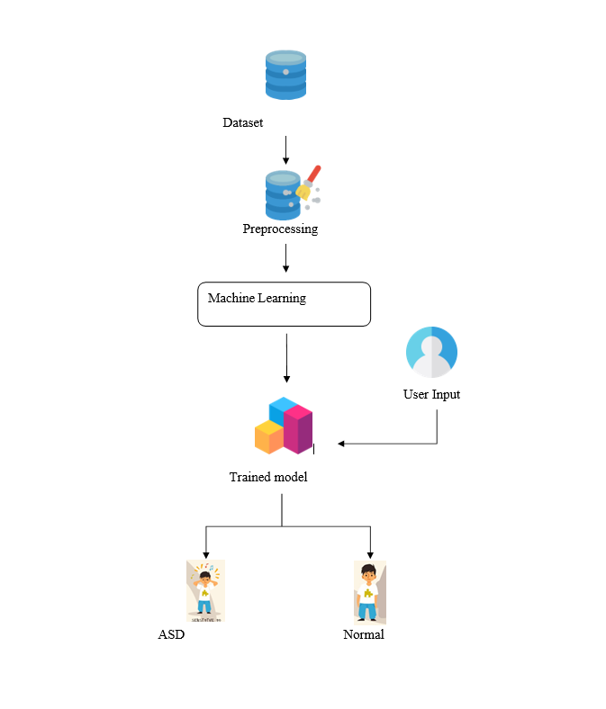
Architecture

Slide 9
Methodology used
We collect the four ASD datasets (Toddlers, Adolescents ,Children , and Adults) from the publicly available repositories: Kaggle and UCI ML the ASD Tests smartphone app for Toddlers ,Children , Adolescents, and Adults ASD screening using QCHAT-10 and AQ-10.
The application computes a score of 0 to 10 for every individual, with which the final score is 6 out of 10 which indicates an individual has positive ASD.
In addition, ASD data is obtained from the ASD Tests app while open-source databases are developed in order to facilitate research in this area.
The detailed description of the Toddlers, Children, Adolescents, and Adults ASD dataset

Slide 10
System Implementation
The Classification Algorithms to produce the best results. We are using KNN, Logistic regression and Random Forest Algorithm to predict the ASD disease using ML. On an analysis conducted within various algorithms, the Logistic Regression was found to provide highest efficiency. Then, the classifiers are applied to each clustered dataset in order to estimate its performance. The best performing models are identified from the above results based on their low rate of error.
Logistic Regression
Naïve bayes
K- Nearest Neighbour

Slide 11
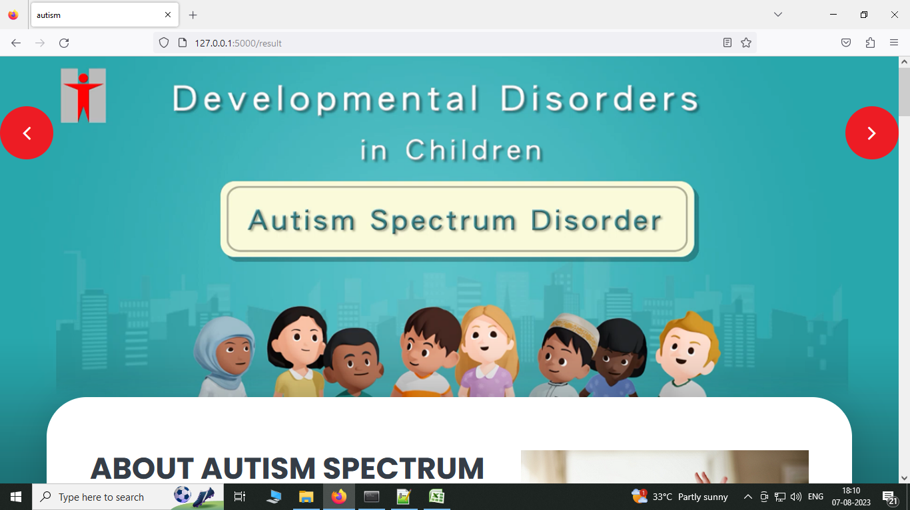
Screenshots

Slide 12
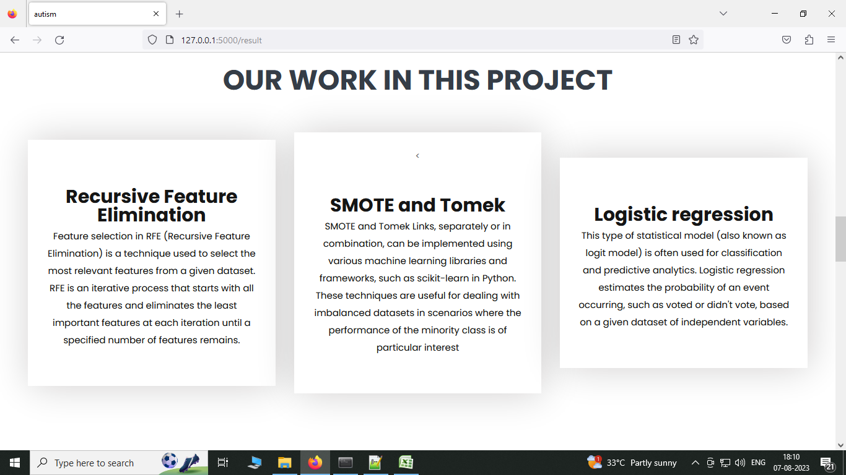
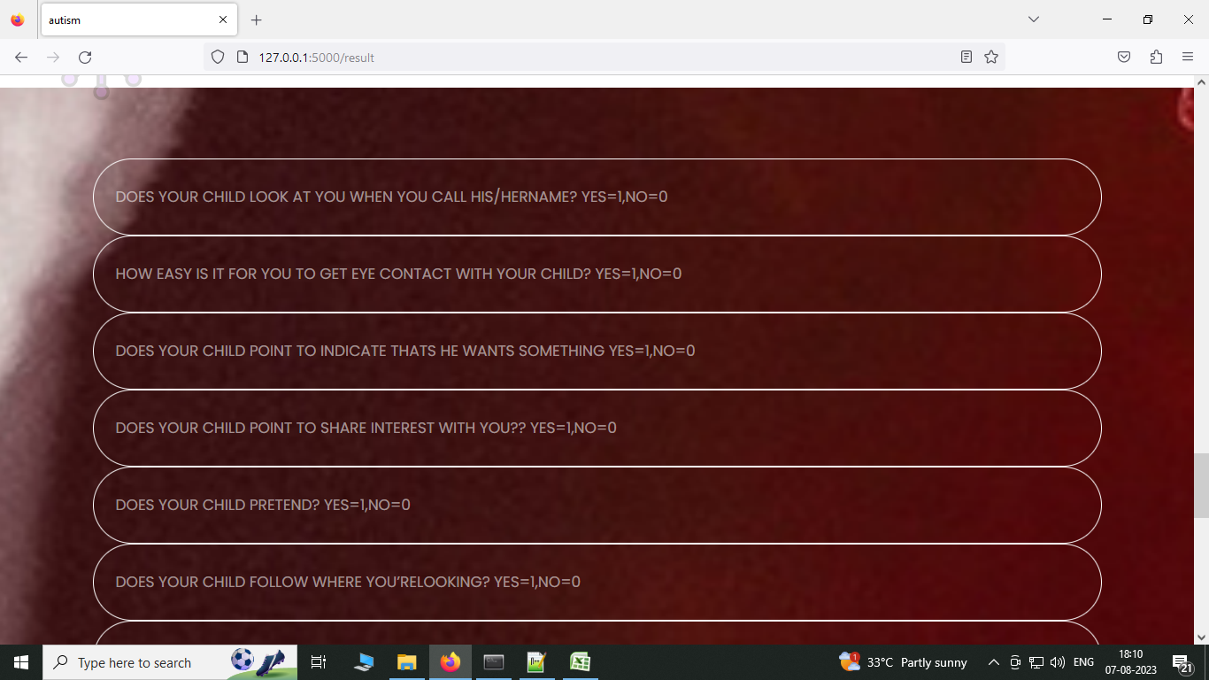

Slide 13
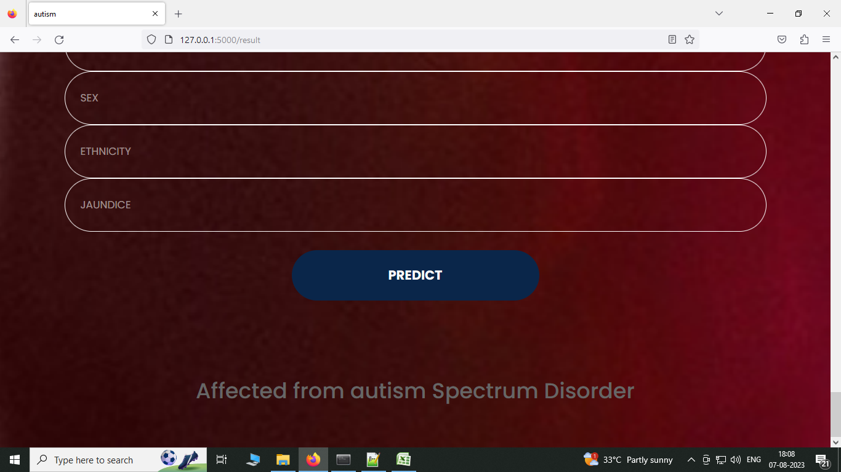


Slide 14
Result & Discussion
Several standard performance metrics such as accuracy, precision and error in classification have been considered for the computation of performance efficacy of this model. Preprocessed data are trained and input given by the user goes to the trained dataset.

Slide 15
Reference Paper/ URL
M. Alsuliman and H. H. Al-Baity, ‘‘Efficient diagnosis of autism with optimized machine learning models: An experimental analysis on genetic and personal characteristic datasets,’’ Appl. Sci., vol. 12, no. 8, p. 3812, Apr. 2022.
S. P. Kamma, S. Bano, G. L. Niharika, G. S. Chilukuri, and D. Ghanta, ‘‘Cost-effective and efficient detection of autism from screening test data using light gradient boosting machine,’’ in Intelligent Sustainable Systems. Singapore: Springer, pp. 777–789, 2022. [34] U. Gupta, D. Gupta, and U. Agarwal, ‘‘Analysis of randomization-based approaches for autism spectrum disorder,’’ in Pattern Recognition and Data Analysis with Applications. Singapore: Springer, pp. 701–713, 2022
M. M. Rahman, O. L. Usman, R. C. Muniyandi, S. Sahran, S. Mohamed, and R. A. Razak, ‘‘A review of machine learning methods of feature selection and classification for autism spectrum disorder,’’ Brain Sci., vol. 10, no. 12, p. 949, Dec. 2020.

